Slide 1
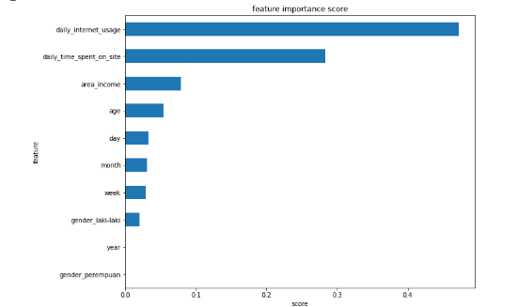
Business Recommendation & Simulation
The 4 most influential features in this machine learning model are daily internet usage, daily time spent on site, area income, and age. Therefore, we can focus ads to the group with the highest click conversion rate based on these 4 features.
For more details, see jupyter notebook here

Slide 2
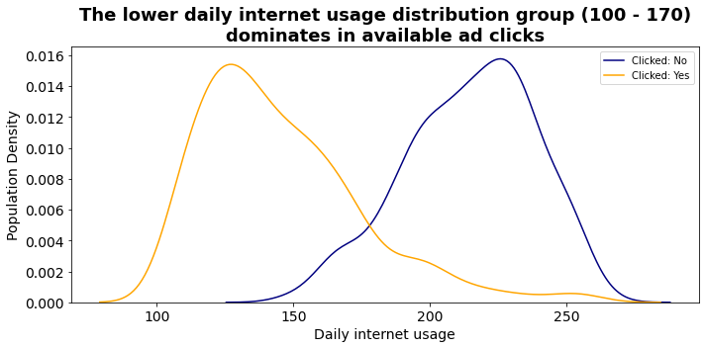
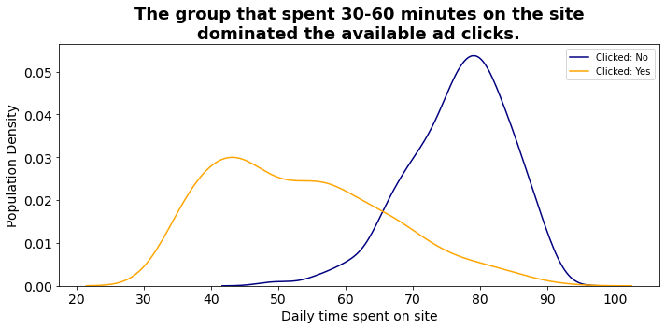
Business Recommendation & Simulation
Since senior internet users and site visitors are less likely to be interested in ads, we can focus ads on new internet users and site visitors.
For more details, see jupyter notebook here

Slide 3
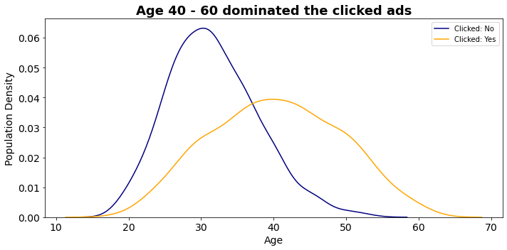
Business Recommendation & Simulation
Because middle-aged and senior users tend to have a higher click conversion rate compared to users with a relatively young age, we can focus on the type of ads suitable for middle-aged / senior users.
For more details, see jupyter notebook here

Slide 4
Business Recommendation & Simulation
Business Simulation (Before Modeling)
Conversion rate = 50%
Ads Cost = 1$ * 1000 user = 1.000$
Average product price = 5$ x 500 = 2500$
Revenue = 2.500$ - 1.000$ = 1.500$
For more details, see jupyter notebook here

Slide 5
Business Recommendation & Simulation
Business Simulation (After Modeling, only focusing ads on customer who will click the ads)
Conversion rate = 500 * 98% (recall score) = 490 user (only focus on these users)
Ads Cost = 1$ * 490 user = 490$
Average product price = 5$ x 490 = 2450$
Revenue = 2450$ - 490$ = 1.960$
For more details, see jupyter notebook here

Slide 6
Business Recommendation & Simulation
Summary
By utilizing machine learning, we can focus our ads on customers who are predicted to click on our ads. By knowing which customers will click, we can reduce the cost of serving ads. Through business simulation, it is found that there is an increase in revenue of 30.67% (from 1500$ to 1960$) by using machine learning to target ads to customers who will specifically click on ads.
For more details, see jupyter notebook here

